Slide 1
Twitter Heron
By
Akhilesh Gattu (5)
Latha Muddu (15)

Slide 2
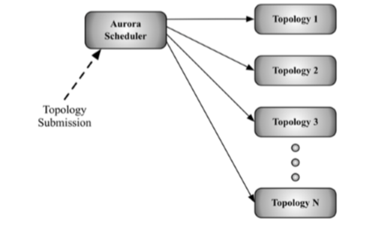
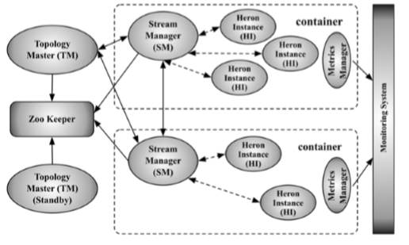
Architecture

